Slide 1
CYB 110 Cybersecurity and privacy module 14 – security assessment Jim Alves-Foss and Jia Song

Slide 2
Defense in Depth
Recall, we are looking at cybersecurity top-down/outside-in
Laws and Compliance
Operations Security
Human Elements of Security
Physical Security
Network Security
Operating System Security
Mobile, Embedded System, Internet of Things
Application Security
Assessing Security (Ch 14)

Slide 3
How and what to assess
Recall from discussion of compliance and regulations, we need to assess security of our systems. What does this mean and how do we do it?
Vulnerability Assessments
Generally assumed to be a review of known vulnerabilities
Can include “classes” of vulnerabilities
Penetration Testing
Generally assumed to look for gaps in security, even unknown vulnerabilities
Addresses the Human Factor, and Physical Security
Understanding and Using the Results
Avoid Analysis Paralysis

Slide 4
Vulnerability assessment
Takes several steps.
Mapping and Discovery
To be able to scan for vulnerabilities in your system, you need to know your system.
(True story: During a visit to NASA JPL in southern California, found they had a contract with a southern California utility company. The utility needed help “mapping and discovering” their power grid and all components of it.)
This is actually a common problem in large organizations

Slide 5
mapping
Mapping the environment means creating a diagram/database of all devices on your network.
You can use tool such as nmap to help discover devices.
There are many tools to keep track of devices and to show them in a network diagram.
For critical infrastructure/cyber physical systems, this should be easier. Devices are not added often. Network is well regulated.
Conversely, for corporate network, with mobile devices, the map is ever changing.

Slide 6
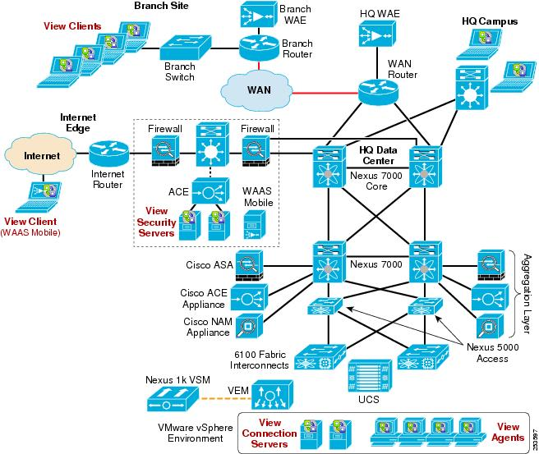

Slide 7
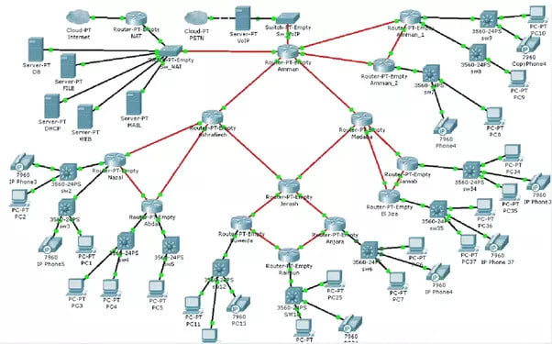

Slide 8
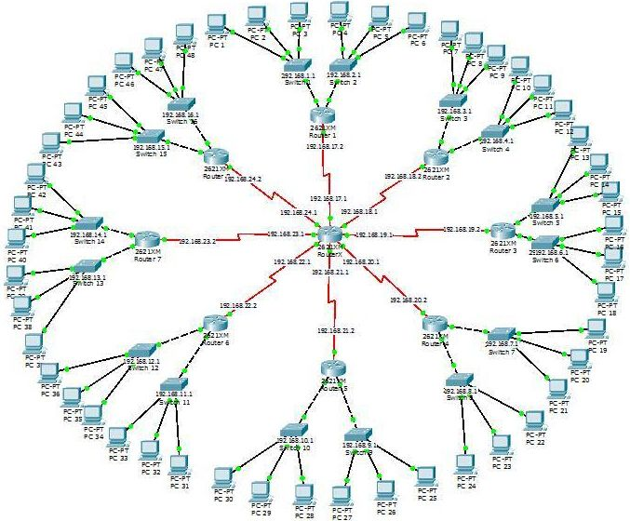

Slide 9
discovery
How do we find new devices/hosts on the network?
What are the characteristics of these devices that we need to know?
What could go wrong? (What makes this difficult?)
Breakout groups: Answer these questions:

Slide 10
Discovery (part 2)
Network consists of physical and wireless devices.
Physical: The wire goes through a network “switch”. That switch, if “managed”, can provide information to IT team about the MAC address of device.
Wireless: The device connects with a wireless protocol to a network access point. That access point, if “managed” can provide information to IT team about MAC address of device.
Each newly connected device should be registered with system. Can use automated support for this. Should include information about OS, description of hardware.

Slide 11
Discovery (part 3)
Need to differentiate between infrastructure devices (servers) and end-user devices (desktops, mobile devices).
Devices have IP address(es) associated with them.
These may be permanently fixed (MAC to IP mapping) – typical for infrastructure. Also, DNS will map name to fixed IP.
These may be auto generated (DHCP), changing each time device is connected.
Infrastructure can also provide restrictions/limitations. Authorize MAC addresses to certain ports.
Private subnetwork, admin network.

Slide 12
DIscovery (part 4)
What can go wrong?
Can hide multiple devices behind NAT router.
Can spoof/change MAC address.
Can spoof/change IP address of device.
Can lie when registering device.
Can insert network device (switch/hub/router) that will act as “man-in-the-middle”.
Takes long time to scan full network for devices – they may not always be present. (Easier to have network devices send alerts every time new device detected – be careful that attack can not overwhelm system).

Slide 13
scanning
Once we know the devices, then we scan for vulnerabilities:
Unauthenticated scans look at the device from the outside, with no log-in permissions.
nmap-style tools can do this by checking what ports are open, what services are available.
Warning: some devices (especially in cyberphysical systems/embedded systems) expect well crafted packets and may crash when there is an arbitrary scan.
Authenticated scans allow you to log in to services on the devices to collect more information. Or log in as a user of the device to query the OS
Need to keep credentials up-to-date. Having common credentials to log into all machines may cause a security problem, unless using SSO.

Slide 14
Scanning (2)
Agent-based scans. Have special software running on each device.
This software can be queried without requiring a full login to the system.
Always runs
Can set alerts to central system, does not have to wait for queries.
Requires that user does not disable agent.
Application scans. Some tools allow you to scan specific applications – especially web applications.
https://portswigger.net/burp -- Burpsuite is a well known web scanner

Slide 15
Scanning (3)
Challenges with Vulnerability Scanning:
What if you are hosting “in the cloud”. You may not be able/allowed to scan everything.
VMs will often be turned on and off
Containers – which are virtualized execution environments (but not full VMs).
Within a machine I can start a container and suddenly have access to several applications and services that are not available in the base machine. When the container is exited, those applications are now hidden from the base machine.

Slide 16
Penetration Testing
Sometimes called pentesting, or ethical hacking.
Is process of testing a system for vulnerabilities that a hacker could exploit.
Goal is to find the holes in security the way an attacker might, and fix them before the attacker gets in.
White hat hackers –Those that use the tools for good, usually working with the company.
Black hat hackers – Those that use the tools for corrupt purposes.
Grey hat hackers – Those who do not have malicious intent, but may violate ethical practices.

Slide 17
Phases of pentesting
Scoping:
What are the targets of the test? Usually this is defined by the client.
All web apps on this website (used for testing)
All assets of my company.
All development machines, but not production machines.
There will also be “rules of engagement”
Times of day
Network load limits
How vulnerabilities are reported

Slide 18
Phases of pentesting (2)
Reconnaissance:
Research conducted before attempting attacks
Search internet for information about target
Look at job listings that specify technologies (HW, SW, Apps)
Look for postings requesting help
Look for email addresses of company employees, domains of the company.

Slide 19
Phases of pentesting (3)
Finding Emails
theharvester in kali linux -- may not be the best tool
hunter.io -- website for emails at certain companies
Finding subdomains
sublist3r -- finding subdomains (can use threads)
crt.sh -- finding subdomains
owasp amass -- used for a lot of people in bugbounties (can be configured)
tomnomnom/httprobe -- probes websites and domains to see if "alive“

Slide 20
Phases of pentesting (4)
Identifying website technologies
builtwith.com -- great first pass tool
wappalyzer firefox (as a plugin) -- top right plugin (more active reconnaisance -- just visits website)
whatweb -- gives information about website

Slide 21
Phases of pentesting (5)
Discovery
This is the active testing stage, where you run vulnerability testing tools
Webhacking
Burpsuite -- a webproxy
Try it yourself:
kioptrix (a vulnerable VM)
vulnhub – (google vulnhub oscp boxes)

Slide 22
Phases of pentesting (6)
Exploitation
So, you think you found a hole. Can you actually exploit it?
Can you see contents of a file that is not allowed?
Can you change configurations?
Can you run arbitrary code?
Privilege escalation?
If an ethical hacker can demonstrate an exploitation, then the company will listen.

Slide 23
Phases of pentesting (7)
Reporting
The last, but very important phase, is reporting the results.
You must carefully document vulnerabilities you detected, and exact steps to duplicate the results.
Different from vulnerability assessment, because here your reports show HOW an exploit can occur.
There are some good examples out there for pentest reports.
Example used here: https://tbgsecurity.com/wordpress/wp-content/uploads/2016/11/Sample-Penetration-Test-Report.pdf

Slide 24
Classifying PENTESTS
Levels of opacity (how much we know about the inner workings)
Blackbox testing: No knowledge of environment other than the testing scope. Simulates a real-world attacker’s knowledge.
Greybox testing: Some inside information about the environment being tests (past known vulnerabilities, specific software, etc).
Whitebox testing: You know everything about the environment, hosts, networks, applications, users, etc.
If you are testing specific applications, you have the source code, build documents, bug/change reports, test suites, etc.

Slide 25
ClassiFying pentests (2)
Environmental Access
External: Pentesters have access from external networks only – like a real remote hacker.
Internal: Pentesters have access to internal network – like an insiders, or a hacker who made it through the firewall to a single host – which is used as a launching point for further attacks.
Team
External: This refers to an independent group or company conducting the pentest
Internal: This refers to employees of the company performing the tests.

Slide 26
Targets of pentests
Network Penetration Tests
Term defined overarching pen testing of many hosts in a network.
Usually, limited timeframe
Application Penetration Testing
Focuses directly on applications
Static Analysis – reviews source code and resources, binary
Dynamic – tests program in execution

Slide 27
Targets of pentests (2)
Physical Penetration Testing
Common part of full pentest (drafting, bypassing alarms, getting into wiring closet)
Social Engineering Testing
Almost always succeed.
Phishing emails, impersonating employees over phone/chat./social media or in person
Hardware Testing
Usually when IoT or Embedded systems are important to the mission

Slide 28
Bug bounties
Companies will pay for people to try to break into their systems
Directly from companies
Organized groups:
Hackerone.com
Bugcrowd.com
Synack.com

Slide 29
Pentesting challenges
The cloud
May not be allowed to fully test (cloud providers don’t like it)
Targets dynamically come and go
Finding Skilled Testers
Good Pentesters are rare to find
If you get a good report, does that mean your system is good, or the pentesters are not good.

Slide 30
Understanding Results
Realistic Testing:
Accurate results require realistic testing
Rules of Engagement
Can not be so restrictive that it can not be realistic
Scoping
Same thing – if you ignore important parts of the system, you may still be vulnerable
Testing Environment
Make sure test environment matches production environment

Slide 31
Own Security
Can you detect your own attacks?
Monitor system when the red-team (pentesting) engages. Do nothing special, and then do post engagement analysis
Blue team – This is your normal IT/security team. They should not try to actively block red-team
Purple team – This is a bridge between the two teams especially if red team needs help from blue team, or blue team knows detected attacks are part of test and not real attacks.
Instrumenting and Alerting

Slide 32
Please attribute Dr. Jim Alves-Foss and Dr. Jia Song, University of Idaho Except where otherwise noted, this work is licensed under https://creativecommons.org/licenses/by-nc-sa/4.0/ Not withstanding the non-commercial license terms, non-profit educational institutions are granted a non-exclusive license to adapt and use this material, with attribution. Creative Commons and the double C in a circle are registered trademarks of Creative commons in the United States and other countries. Third party marks and brands are the property of their respective holders.

